Slide 1
“How Alibaba and A&J Help Increase Export”
Akik Ahmed
Assistant Manager , Business Development
Alibaba Global Channel Partner
Amin & Jahan Corporation Ltd.

Slide 2
Some of Our Premium Successful Bangladeshi Supplier/ Manufacturer:
KINSMAN ZI-TEX LTD (14 YEARS*)
Brownfield Limited (Buying House-8 years*)
Abedin Group ( Leather & Garments Manufacturer)
Lanpino Bangladesh ( Undergarments Manufacturer)
Odyssey Sourcing BD (Manufacturer/Supplier)
Eco Bangla Jute Ltd ( Jute Diversified Manufacturer -4 years*)
Yuko Leather Goods Ltd (Leather Manufactuer-5 years*)
Kazi Food Industries Ltd ( Agro/Process Food Supplier)

Slide 3
Special $900 onboarding service fully Free
Alibaba webpage Design
Alibaba Showcase decoration
Alibaba product uploading & resize.
Alibaba Regular page maintenance & update.
Alibaba B2B professional Training
Keyword Advertising (SEO & Promotions)
Product Photography ( Up to 300 Products)

Slide 4
How A&J can help you in Alibaba
Being 14 years in the industry A&J has better understanding about export market trend. Therefore A&J will guide it’s client in a better way.
A&J has a strong IT team which is capable enough to design professional website and also to solve any technical issues in a shortest possible time.
A&J possesses a professional design and branding team to support all types of design and branding issues
A&J transforms human capital and thus produces skilled professionals able to meet up market demands.
A&J dedicated personnel for Alibaba are always ready to response all queries and solve in a shortest possible time.

Slide 5
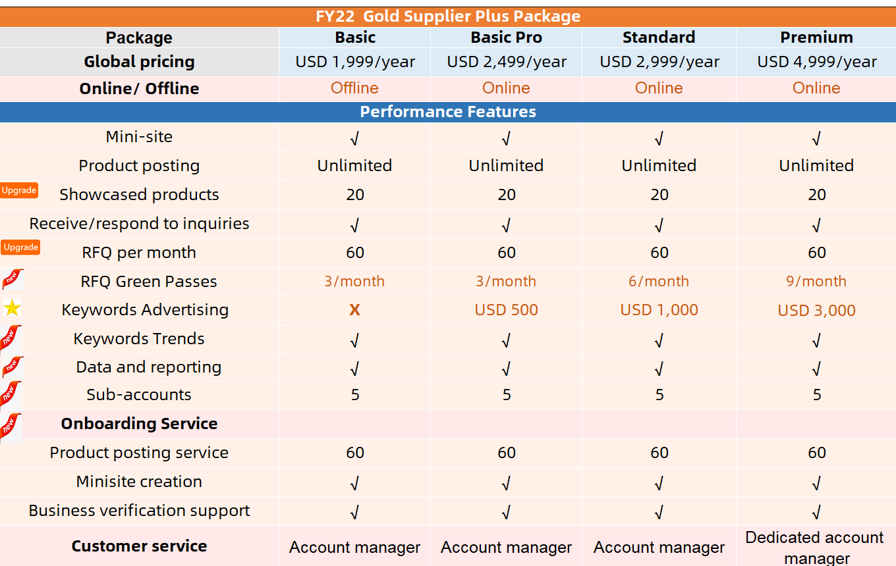
Alibaba.com GGS offers (Q3)
Main Feature | Gold Supplier Membership
 | Premium Package | Standard Package | Basic Package
Priority Ranking | 1st | 2nd | 3rd
Product Posting | Unlimited | Unlimited | Unlimited
Product Showcase | 28 | 12 | 5
Ability to quote Buying Request | Y | Y | Y
Verified Icon | Y | Y | Y
Customized Website | Y | Y | Y
Photo Bank Size | 5GB | 3GB | 1GB
Sub-accounts | 5 | 5 | 5
Biz Trends – My Performance | Y | Y | Y
Biz Trends – Industry Analysis | Y | Y | Y
Package Price | $4,999/ $4,899 (5%) | $2,999/ $2,899 (5%) | $1,399/ $1,357 (3%)

Slide 6
Access an enormous pool of qualified global buyers
Top 10 countries
United States
Turkey
UK
Australia
Canada
Russia
Mexico
Brazil
Germany
France

Slide 7

Any Questions or Feedback
For more detail; Please contact
Akik Ahmed
Assistant Manager , Business Development
Alibaba Global Channel Partner
Amin & Jahan Corporation Ltd.
Contact : 01799-391077

